Slide 1
Conflicts

Slide 2
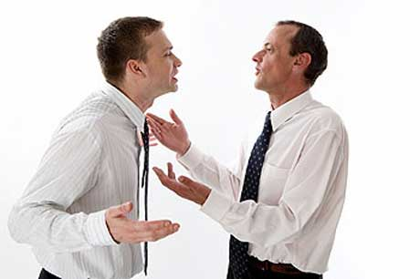
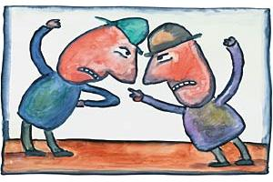
Conflicts is a natural thing in our life.
Conflicts happen because people are different: they want different things, they have different ideas and their values are different. Very often people have conflicts because they do not listen to each other well. They think about what they want to say and don’t really hear what the other person is saying.

Slide 3
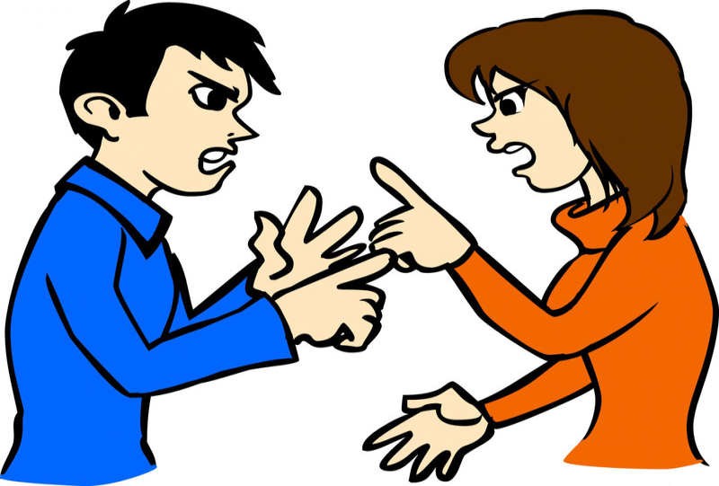
Conflicts are different. But they are all began when people misunderstanding each other.

Slide 4
Conflicts between classmates

Slide 5
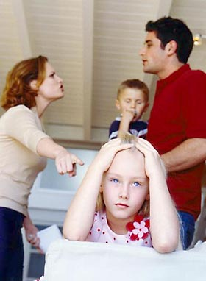
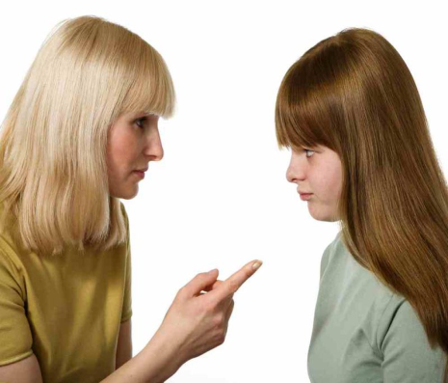
Conflicts in a family.

Slide 6
Political conflicts

Slide 7
In literature there are many conflicts. As an example, I can offer the novel by A.S. Griboedov “Woe from Wit”.
Basic conflict here is confrontation between the representatives of the past and present centuries, so called “generation gap”
I advice you to read this book.

Slide 8
Every day you are in contact with people whose values are different from yours. And you have the right to disagree with their values. But you should understand that other people also have the right to be different from you. You must respect the right of other people to have ideas that differ from your ideas. People who respect each other’s ideas can resolve conflicts in a peaceful way. If people resolve conflicts peacefully, they will have better relations in the future.

Slide 9
Be happy and avoid conflict situations

